Slide 1
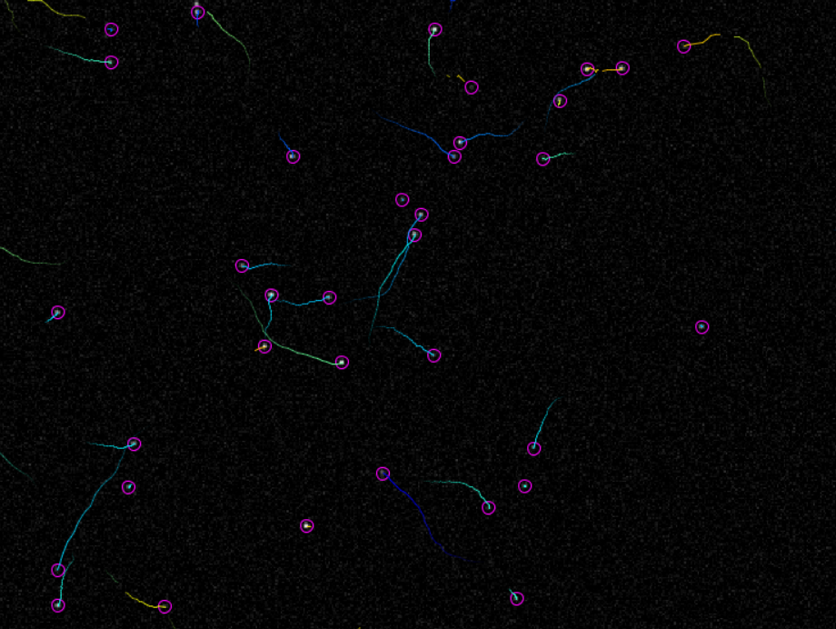
Introduction to Tracking

Slide 2
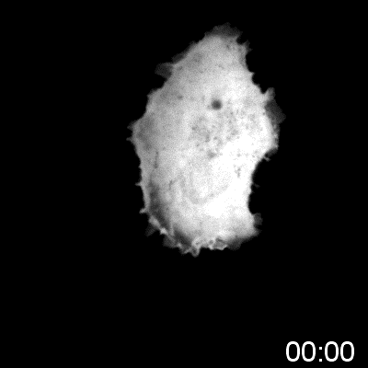
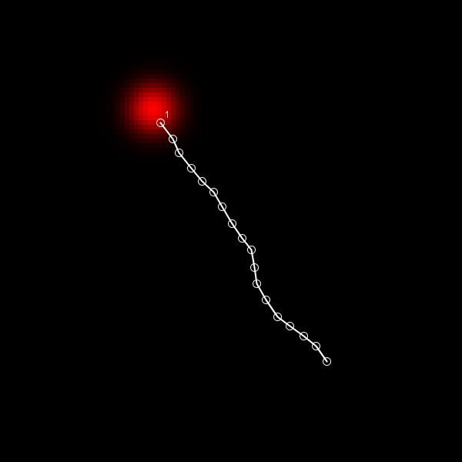
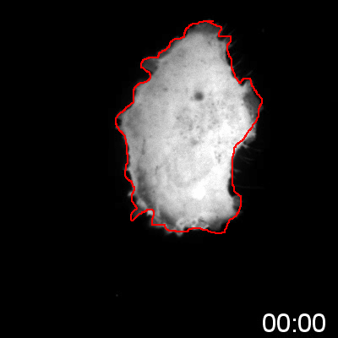
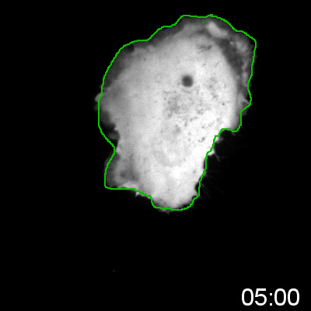
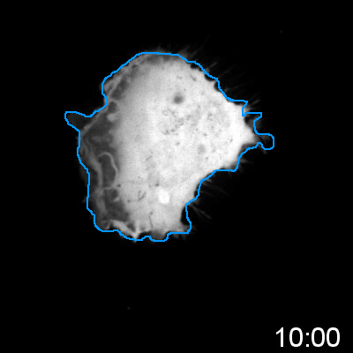
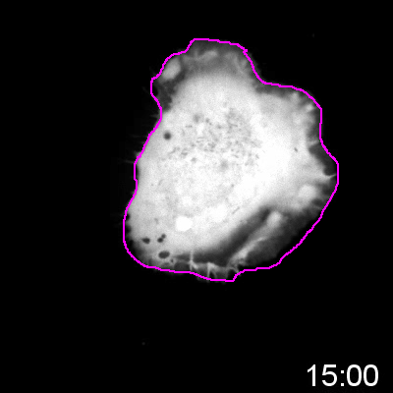
Common experimental output
Typically quantified manually:
Time-consuming
Inaccurate
Biased

Slide 3
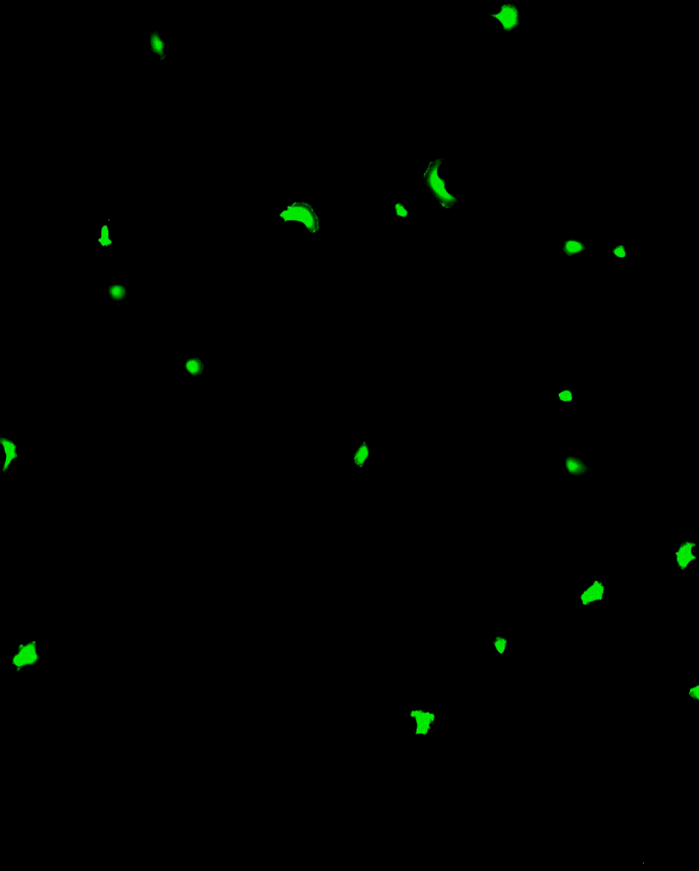
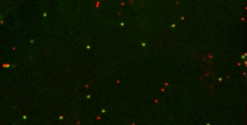
Problems generally involve cells or sub-cellular particles

Slide 4
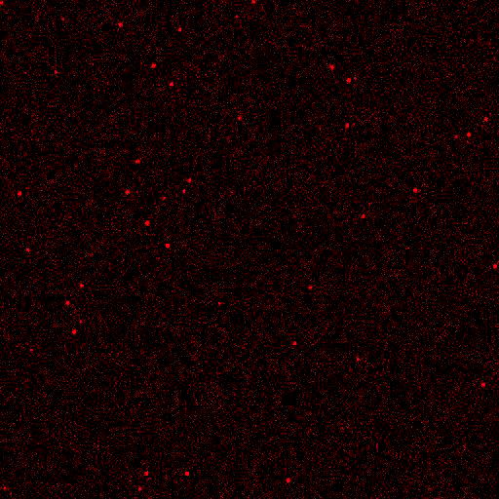
We’ll mostly be using synthetic Images
Diffraction-limited dots good model for detection algorithms

Slide 5
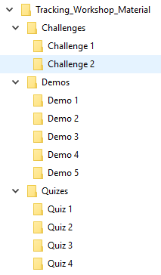
There is a prize (and pride) at stake
2 Teams
4 Quizzes - 13 Points in total
2 Challenges - 12 Points in total
Team with highest score in June 2020 wins a prize
Team with lowest score will be named & shamed

Slide 6


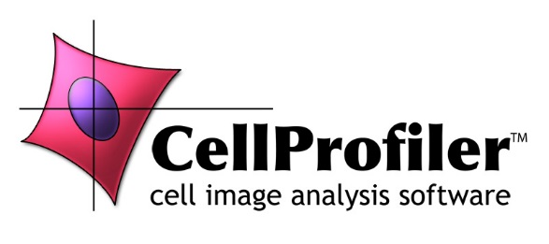
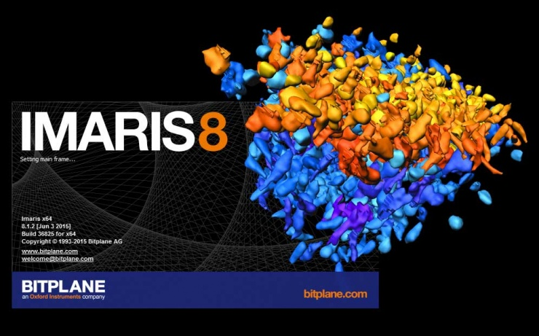
In terms of software…
Most employ similar algorithms
FIJI plugins:
TrackMate
QuimP
ADAPT
CellProfiler
Numerous Commercial Packages:
Imaris
Arivis
Huygens
MetaMorph
Phasefocus Livecyte

Slide 7
Two common methodologies
Detect then track:
Detect objects in each frame
Associate detections
Detect, propagate, detect:
Detect objects in first frame
Evolve detection

Slide 8
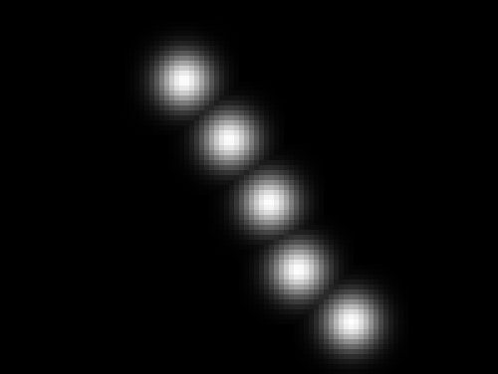
Demo 1 – manual tracking
Manual tracking with MTrackJ:
Enable ImageScience update site
Track object and measure velocity

Slide 9
QUIZ 1 – limitations of manual tracking
Open the datasets in the Quiz 1 folder.
2 Points:
What is the mean speed of the particle in each data set?
1 Point:
No matter how careful you are, the result you get will be wrong! Why?

Slide 10

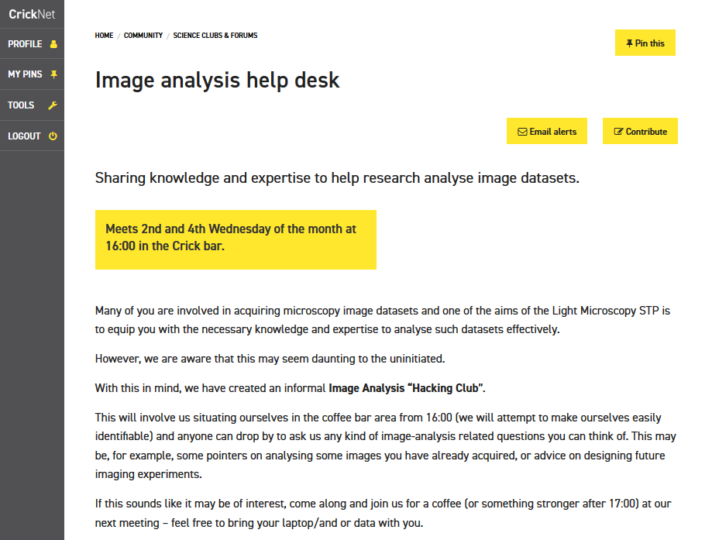

SW302 ● david.barry@crick.ac.uk

